Slide 1

Condition Variables
PASS: see important feedback comment. No need to resubmit.
CS532: OS Foundations
Lab Assignment
email address: parth2@pdx.edu
partner’s email address:

Slide 2
Instructions: Make a copy of this document, move your copy to your submissions folder and fill the document with your responses. Use the space on each slide to show your responses, and add additional slides as needed.
When ready for grading: complete the lab assignment submission form and include a link to your filled document

Slide 3
pingpong.c
Your assignment is to read, understand, build, run and fix the pingpong.c program so that its two threads correctly take turns printing their output lines. Begin by reading and understanding the source code which is linked from the course plan document.
Next, build and run the original program. When you run the original version it should fail.

Slide 4
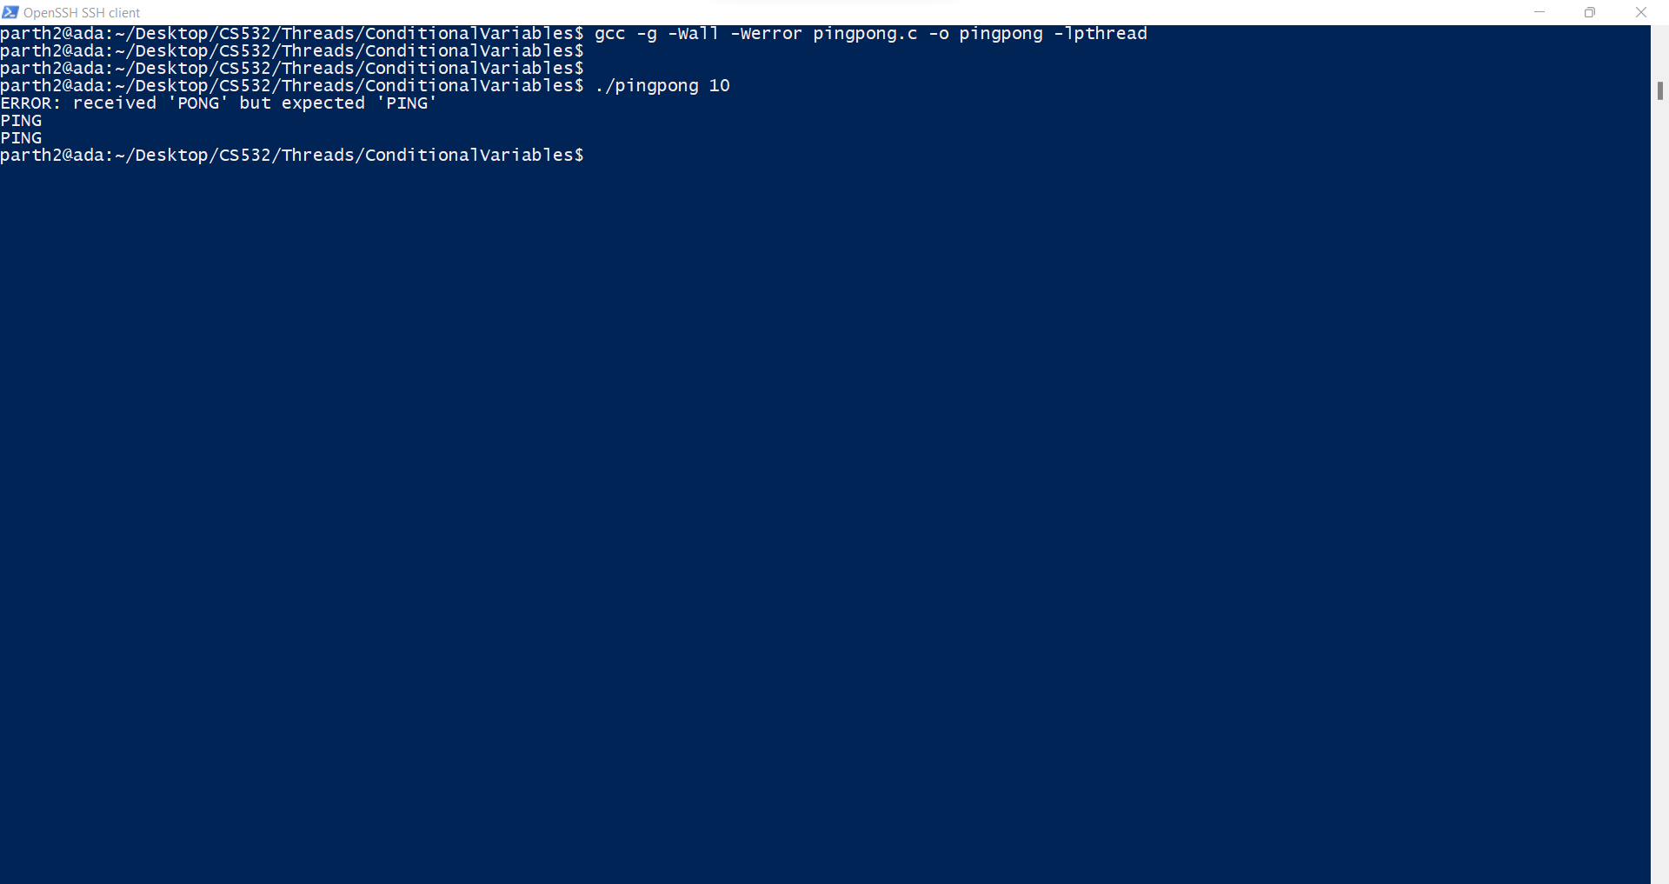

Slide 5
1. Why does the original pingpong program fail? What is wrong with it?
Answer: - The original PingPong program fails because there was no synchronisation between the threads as they were trying to access the same variable and in the process, when one thread would change the value and use this changed value to calculate the next step, then during the same time, the common variable was changed by the other variable. This leads to a situation where the program will not execute as expected.
In case of pingpong, the variable changing are : -
tid
thisVal
prevVal

Slide 6
2. Modify the pingpong.c source code to produce a new version called pingpong2.c that correctly, consistently, successfully outputs the correct pattern of PING and PONG. Test pingpong2 with varying number of rounds such as 10, 100, 1000, 10000, etc. It should work every time, regardless of the number of Rounds. Your code must properly use a condition variable to coordinate the two threads taking turns.
Upload your pingpong2.c file to your submissions folder and provide a link to it here: link
https://drive.google.com/file/d/1w5KUd81Ea7erws54HMyEB1-7s3aPJsmk/view?usp=sharing

Slide 7
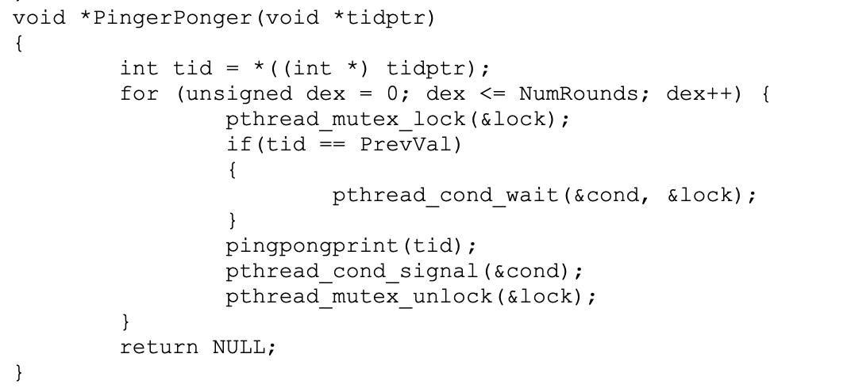
This if{} must be a while{} . Always, always, always contain a call to pthread_cond_wait() within a while loop, not an if statement.

Slide 8
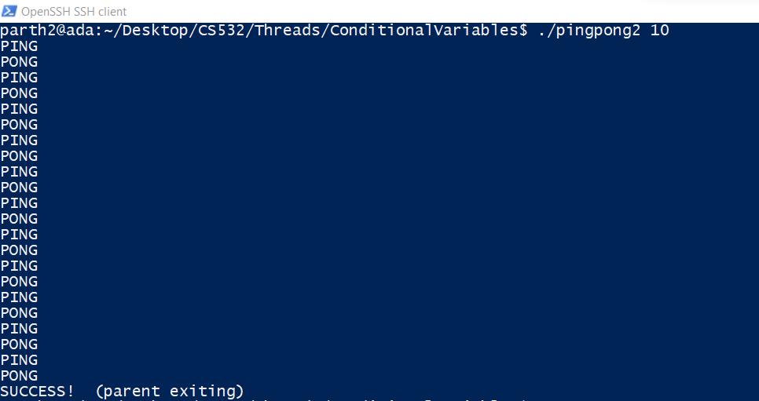

Slide 9
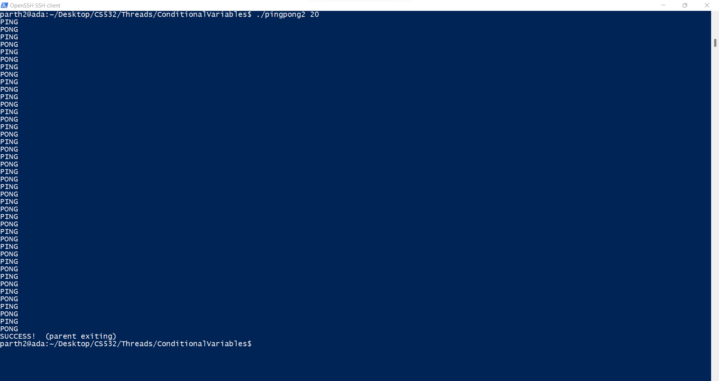

Slide 10


Slide 11
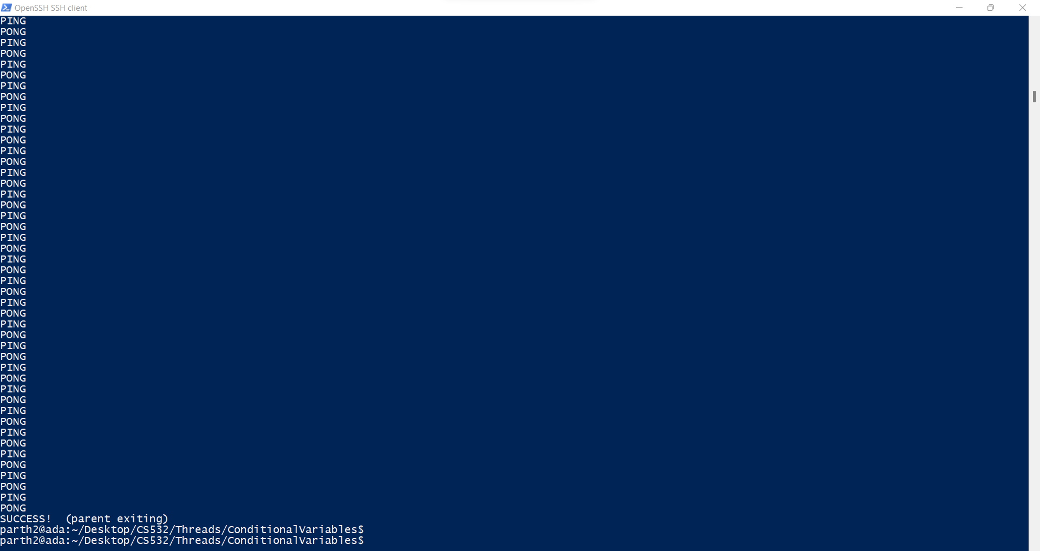

Slide 12


Slide 13
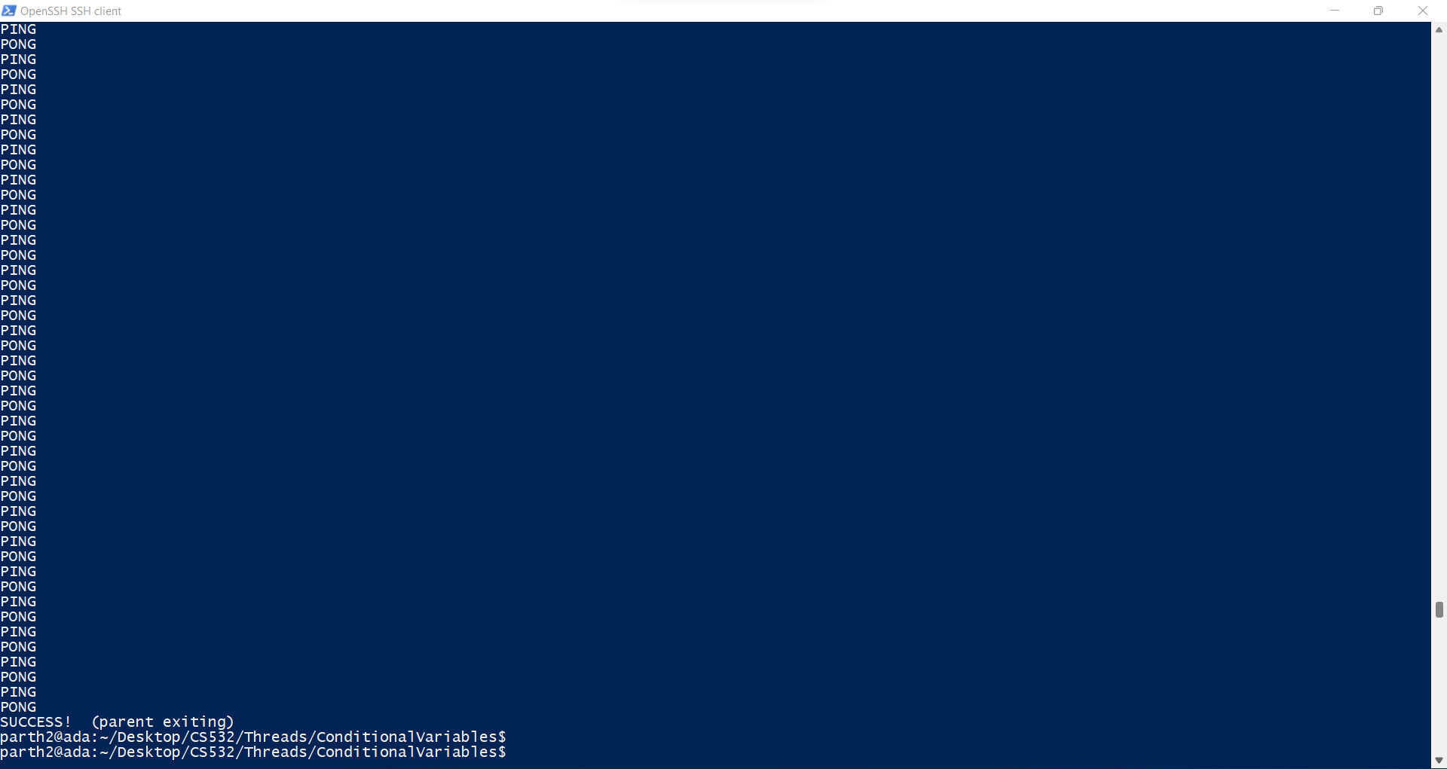

Slide 14
#include <pthread.h>
#include <stdio.h>
#include <stdlib.h>
#include <unistd.h>
#define PING 0
#define PONG 1
pthread_cond_t cond = PTHREAD_COND_INITIALIZER;
pthread_mutex_t lock = PTHREAD_MUTEX_INITIALIZER;
volatile unsigned NumRounds = 0;
volatile unsigned PrevVal = PONG;
char *Message[2] = {"PING", "PONG"};
void pingpongprint(int thisval)
{
if (PrevVal == thisval) {
fprintf(stderr, "ERROR: received '%s' but expected '%s'\n", Message[thisval], Message[!thisval]);
exit(-1);
}
printf("%s\n", Message[thisval]);
PrevVal = thisval;
}

Slide 15
void *PingerPonger(void *tidptr)
{
int tid = *((int *) tidptr);
for (unsigned dex = 0; dex <= NumRounds; dex++) {
pthread_mutex_lock(&lock);
if(tid == PrevVal)
{
pthread_cond_wait(&cond, &lock);
}
pingpongprint(tid);
pthread_cond_signal(&cond);
pthread_mutex_unlock(&lock);
}
return NULL;
}
int main(int argc, char *argv[])
{
if (argc != 2) {
fprintf(stderr, "USAGE: %s <numrounds>\n", argv[0]);
exit(-1);
}

Slide 16
NumRounds = atoi(argv[1]);
if (NumRounds < 1) {
fprintf(stderr, "ERROR: NumRounds must be >= 1\n");
exit(-1);
}
int ping_tid = PING;
int pong_tid = PONG;
pthread_t pingthread;
pthread_t pongthread;
int rc;
rc = pthread_create(&pingthread, NULL, PingerPonger, (void *) &ping_tid);
if (rc) {
fprintf(stderr, "ERROR; could not create PING thread. return code from pthread_create() is %d\n", rc);
exit(-1);
}
rc = pthread_create(&pongthread, NULL, PingerPonger, (void *) &pong_tid);
if (rc) {
fprintf(stderr, "ERROR; could not create PONG thread. return code from pthread_create() is %d\n", rc);
exit(-1);
}

Slide 17
rc = pthread_join(pingthread, NULL);
if (rc != 0) {
fprintf(stderr, "ERROR joining with PING (rc==%d)\n", rc);
exit(-1);
}
rc = pthread_join(pongthread, NULL);
if (rc != 0) {
fprintf(stderr, "ERROR joining with PONG (rc==%d)\n", rc);
exit(-1);
}
printf("SUCCESS! (parent exiting)\n");
return(0);
}

Slide 18
3. Could you have implemented pingpong2 correctly with nothing more than mutexes (i.e., without the use of condition variables)? Would it have been simpler that way?
Answer:- pingpong2 would have been really difficult to implement using nothing more than mutexes. If it had to be done, then it had to involve some variable that could signal the threads when to run and when to wait. It also would have required the use of sleep(1) which wastes a lot of CPU time and is not a good programming practice.
The runtime of pingpong would be very high and generally would not be considered as efficient.
Conditional Variables help in simplifying the solution and works great for pthreads and in general multithreaded environments.

